Slide 1
Lecture - 2

Slide 2
Introduction
In reality, organizations have many other things to do than practice security. Businesses exists to make money
No organization specifically deploys and maintain firewalls, intrusion detection systems, identity management technologies, and encryption devices
No business really wants to develop hundreds of security policies, deploy antimalware products, maintain vulnerability management systems, constantly update their incident response capabilities, and have to comply with the alphabet soup of security regulations

Slide 3
What is Needed?
But these simpler days are long gone. Now organizations are faced with attackers who want to steal businesses’ customer data to carry out identity theft and banking fraud
Company secrets are commonly being stolen by internal and external entities for economic espionage purposes. Systems are being hijacked and being used within botnets to attack other organizations or to spread spam
Each organization must develop an enterprise- wide security program that consists of technologies, procedures, and processes

Slide 4
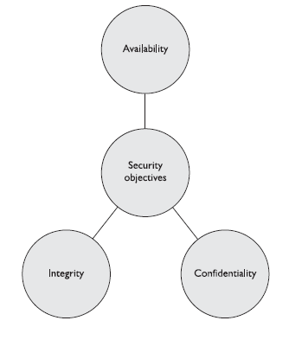
Security Triad

Slide 5
Availability
Ensuring the availability of the necessary resources within an organization sounds easier to accomplish than it really is
Networks have so many pieces that must stay up and running (routers, switches, DNS servers, DHCP servers, proxies, firewalls).Software has many components that must be executing in a healthy manner (operating system, applications, antimalware software)
There are environmental aspects that can negatively affect an organization’s operations (fire, flood, electrical problems), potential natural disasters, and physical theft or attacks
An organization must fully understand its operational environment and its availability weaknesses so that the proper countermeasures can be put into place.

Slide 6
Integrity
Environments that enforce and provide this attribute of security ensure that attackers, or mistakes by users, do not compromise the integrity of systems or data
When an attacker inserts a virus, logic bomb, or back door into a system, the system’s integrity is compromised
Users usually affect a system or its data’s integrity by mistake. For example, users with a full hard drive may delete config files under the mistaken assumption that deleting a boot.ini file is okay.

Slide 7
Confidentiality
Confidentiality can be compromised by a variety of means from shoulder surfing to social engineering.
Users can intentionally or accidentally disclose sensitive information by not encrypting it before sending it to another person, by falling prey to a social engineering attack, by sharing a company’s trade secrets, or by not using extra care to protect confidential information when processing it.

Slide 8
Balanced Security
In reality, when information security is dealt with, it is commonly only through the lens of keeping secrets secret (confidentiality).
The integrity and availability threats can be overlooked and only dealt with after they are properly compromised
Some assets have a critical confidentiality requirement (company trade secrets), some have critical integrity requirements (financial transaction values), and some have critical availability requirements (e-commerce web servers)
Many people understand the concepts of the AIC triad, but may not fully appreciate the complexity of implementing the necessary controls to provide all the protection these concepts cover

Slide 9
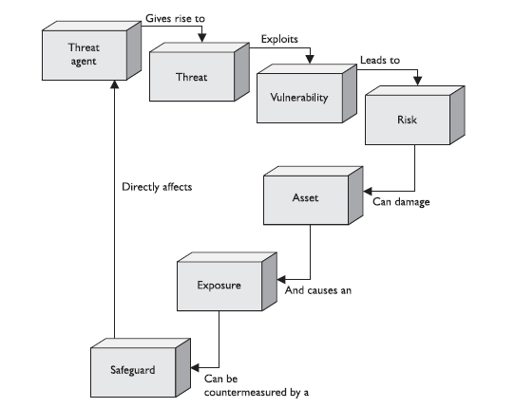

Slide 10
Business Objectives
What is the Business Objective of an organization ?
To Deliver ABC services to Corporate or normal Clients and achieve an annual turnover of XYZ million Rs/$ at a profit of ABC%

Slide 11
An Organization..
Organizational Objectives
Conducive Working Environment
External & Internal Factors
Operational Risks
Events, Activities or circumstances that can affect an organization and achievement of business objectives
Smooth Processes/ Operations
and Stability of Related Resources

Slide 12
Operational Risks
Management Information Risk
Inadequate, inaccurate, incomplete or untimely provision of information to support the management decision making process
Facilities and Operating Environment Risk
Loss or damage to operational capabilities caused by problems with premises, facilities, services or equipment
Legal and Regulatory Compliance Risk
Failure to comply with the laws of the country/state/region

Slide 13
Technology Risks
Failure to plan, manage and monitor the performance of technology related projects, products, services, processes and delivery channels
Criminal and Illicit Act Risk:
Loss or damage caused by fraud, theft, willful neglect, gross negligence, vandalism, sabotage, extortion etc.
Supplier Risk
Failure to evaluate adequately the capabilities of suppliers leading to breakdown in the supply process or substandard delivery of supplied goods and services
Climate and Environmental Risk
Loss or damage caused by unusual climate conditions including natural disasters like flood, storm etc.

Slide 14
Issues Generate Risks
Which issues can give rise to the above risks?
OR
Which issues damage or disrupt our operations, business process and/or related resources?

Slide 15
Departmental Issues
Information Security is just related to the IT department and IT security is termed as Information Security and only the IT Head is considered responsible for this.
Lack of policies and procedures for handling different type of information and data including sensitive data resulting in leakage of sensitive/critical information.
Unauthorized use of laptops. Company's sensitive information traveling on the laptops without any protection.
Open use of USBs, Wi-Fi, CDs, Bluetooth or other means for sharing the information
No Inventory of Information Asset and their owners (responsible) are not identified

Slide 16
Departmental Issues
No Security Incident Reporting and Management mechanism
Open use of public wireless networks by company top officials
Classified/important documents placed/stored at an unspecified location or open cabinets/draws
Rooms of top managers left open
Visitors roaming around within the office premises

Slide 17
Personal Issues
Open verbal communication about official matters
Lack of awareness among the staff regarding the seriousness and gravity related to the information
Lack of disciplinary actions policies for the personnel involved in a security breach
Documents / information lying open on the tables or screens or systems / PCs left unattended
Passwords are shared with friends / colleagues
No policy for the screening of the staff and non existence of the confidentiality agreement

Slide 18
Personal Issues
Contract with personnel and external parties are without any liabilities/penalties in case of breach of company's security
Excessive unauthorized use of telephone/Mobile phone/SMS/email by the staff
Excessive guests arrivals of the staff within office premises
Staff not reporting the security incidents
Staff not having the awareness about “which situation to call a security incident”

Slide 19
IT Issues
Server down
Network / VPN Link down / connectivity issues
DB / Application / OS failure
IT security measures / controls are based upon the IT
Manager / vendor recommendations
No Standard Operating Procedures (SOPs) for the IT activities and services
Password management

Slide 20
IT Issues
Non existence of the Networks, OS, applications and database access policies especially within IT personnel
No policy/mechanism for the network and database
Storage Medium disposal policies?
Lack of formal backup policies and their periodical testing for retrieval
No policies for periodic review of the ”User Access Rights‘ to different application, databases and utilities
Lack of review of the different system/admin and IT logs

Slide 21
External /Third Party Issues
External/third parties Contracts without proper documentation leading to mishaps and mishandling of information from their end
Critical Third parties and related risks are not identified and evaluated
Contracts without response time from critical third parties
Information leakage by the suppliers and the third/external parties

Slide 22
External /Third Party Issues
No concept of Service Level Agreements or SLA. If exist then without any monitoring mechanism
No alternate arrangements with the supplier in case of the disruption in its services
No mechanism to provide awareness to the third party regarding company security policies
Contract with personnel and external parties are without any penalties in case of breach of company's security

Slide 23
Asset
Property of a person or a company
Information is an asset which, like other important business assets, has value to an organization and consequently needs to be Suitably protected (ISO 27001)
Information/Data asset
Technology Asset
Personnel Asset
Service(s) Asset
Every asset will have an asset owner

Slide 24
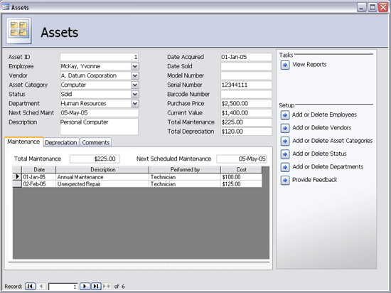
Asset Inventory
All the information assets of these departments should be identified and documented

Slide 25
Suitability
What is Suitable for one organization might not be ”suitable‘ for other organization and vice versa
For e.g. what is suitable for a
State Bank of Pakistan
might not be suitable for
Karachi Stock Exchange

Slide 26
Types of Information
Printed or written on paper
Stored electronically
Transmitted by post or using electronic means
Shown on corporate videos
Verbal or spoken in conversations
Backed up Information
Company publications, newsletters etc.
Employee records

Slide 27
Organizational Objectives
Conducive Working Environment
External & Internal Factors
COMPROMISE THE C I A
OF CRITICAL / INFORMATION ASSETS
Operational Risks
Smooth Processes/ Operations
and Stability of Related Resources
CONTROLS
ISMS Implementation

Slide 28
Security Controls
After studying the AIC triad and understanding the concept of vulnerability, exploit, threat and risk, we move on to studying controls which help safeguard the information of any organization.
Controls are put into place to reduce the risk an organization faces, and they come in three main flavors:
Administrative
Technical
Physical

Slide 29
Administrative Controls
Administrative controls are commonly referred to as “soft controls” because they are more management-oriented. Examples of administrative controls are security documentation, risk management, personnel security, and training
Technical controls (also called logical controls) are software or hardware components, as in firewalls, IDS, encryption, identification and authentication mechanisms
Physical controls are items put into place to protect facility, personnel, and resources. Examples of physical controls are security guards, locks, fencing, and lighting

Slide 30
Defense in Depth
These control types need to be put into place to provide defense-in-depth, which is the coordinated use of multiple security controls in a layered approach
A multilayered defense system minimizes the probability of successful penetration and compromise because an attacker would have to get through several different types of protection mechanisms before she gained access to the critical assets

Slide 31
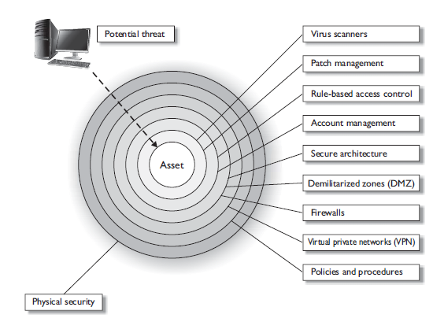
..contd

Slide 32
Controls Categorized
So the different categories of controls that can be used are administrative, technical, and physical. But what do these controls actually do for us?
We need to understand the different functionality that each control type can provide us in our quest to secure our environments.
The different functionalities of security controls are preventive, detective, corrective, deterrent, recovery, and compensating
By having a better understanding of the different control functionalities, you will be able to make more informed decisions about what controls will be best used in specific situations

Slide 33
..contd
Deterrent Intended to discourage a potential attacker
Preventive Intended to avoid an incident from occurring
Corrective Fixes components or systems after an incident has occurred
Recovery Intended to bring the environment back to regular operations
Detective Helps identify an incident’s activities and potentially an intruder

Slide 34
..contd
When looking at a security structure of an environment, it is most productive to use a preventive model and then use detective, recovery, and corrective mechanisms to help support this model.
Basically, you want to stop any trouble before it starts, but you must be able to quickly react and combat trouble if it does find you.
It is not feasible to prevent everything; therefore, what you cannot prevent, you should be able to quickly detect

Slide 35
Preventive Controls : Admin
Policies and procedures
Effective hiring practices
Pre-employment background checks
Controlled termination processes
Data classification and labeling
Security awareness

Slide 36
Preventive Controls : Physical
Badges, swipe cards
Guards, dogs
Fences, locks, mantraps

Slide 37
Preventive Controls : Technical
Passwords, biometrics, smart cards
Encryption, secure protocols, call-back systems, database views, constrained user interfaces
Antimalware software, access control lists, firewalls, intrusion prevention system

Slide 38
Examples
A firewall tries to prevent something bad from taking place, so it is a preventative control.
Auditing logs is done after an event took place, so it is detective
A data backup system is developed so that data can be recovered; thus, this is a recovery control
Computer images are created so that if software gets corrupted, they can be loaded; thus, this is a corrective control.

Slide 39
Compensating Control
Controls that provide an alternative measure of control
If your company needed to implement strong physical security, you might suggest to management that security guards are employed. But after calculating all the costs of security guards, your company might decide to use a compensating (alternate) control that provides similar protection but is more affordable—as in a fence
you are a security administrator and you are in charge of maintaining the company’s firewalls. Management tells you that a certain protocol that you know is vulnerable to exploitation has to be allowed through the firewall for business reasons. The network needs to be protected by a compensating (alternate) control pertaining to this protocol, which may be setting up a proxy server for that specific traffic type to ensure that it is properly inspected and controlled

Slide 40
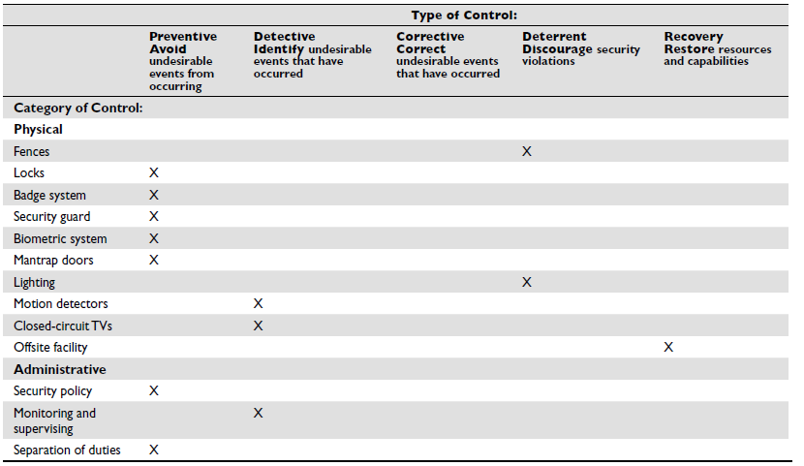

Slide 41
Control Effectiveness
Effectiveness measures whether the Control provides an acceptable level of risk mitigation to the organization.
A Control may exist (for example, the organization maintains a Policy requirement that all employees must change their password every 30 days), but its value is diminished it it is not properly implemented (few employees are aware of the requirement and there is manageable evidence passwords are not being changed).

Slide 42
Control Efficiency
Efficiency measures the cost of maintaining the Control compared to the potential loss if the Control were to fail. This is a cost/benefit analysis where Controls are ideally structured to yield a positive return on investment.

Slide 43
Control Scope
In order to measure the effect from a Control failure, you need to correlate the Scope of the Control (does the Control mitigate the Risk from the loss of Confidentiality, Integrity or Availability) with the Impact of the process (how important is a loss of Confidentiality, Integrity or Availability to the process)
If a Control addresses a loss of Availability, but under Impact Availability is rated as a low risk element, the overall risk from the failure of the Control is likely Low
Conversely, if the Impact assessment rated Availability as a high risk area, then the failure of the Availability Control would have a significant effect on the organization

Slide 44
Control Complexity
How difficult is it to exploit the Control?
Does the exploit require significant resources (i.e. experience, training, money, technology, planning etc.)
In effect, the greater the complexity involved in breaking the Control, the less likely the Control will be exploited.

Slide 45
Control Access
What level of access to the control is required for an exploit to be successful?
Is the Control freely accessible on the Internet or is the Control protected within a guarded data center?
How many people (potential Threats) could access the Control with the resources reasonable available to them?

Slide 46
Control Priviledge
Assuming the Threat can overcome the challenges of Complexity and Access, what level of Privilege will the Threat receive?
For example, a hacker (the Threat) may be able to run a script (an exploit) to gain access to an Internet site
The severity of the exploit would vary greatly based on the level of authority or privilege that the hacker would gain. If the exploit only allows the Hacker to run reports on the system, it would have a lower severity than if the exploit gave the Hacker system administrator access with the power to change or delete code, monitor user activity, etc.

Slide 47
Backup Data Restoral:
Corrective
Anti-Virus:
Detective, Preventive
IPS:
Preventive
OS Upgrade:
Corrective
Security Awareness Training:
Preventive, Deterrent
Vulnerability Mitigation:
Corrective
IDS:
Detective

Slide 48
Encryption:
Preventive
Honeypots
Detective
BCP:
Corrective
Audit
Detective
Review of Performance
Detective
Biometrics:
Preventive
Security Guard/Fence
Deterrent, Preventive
Segregation of Duties
Preventive
Penetration testing
Preventive

Slide 49
Security Through Obscurity
The concept of security through obscurity is assuming that your enemies are not as smart as you are and that they cannot figure out something that you feel is very tricky
A nontechnical example of security through obscurity is the old practice of putting a spare key under a doormat in case you are locked out of the house
You assume that no one knows about the spare key, and as long as they don’t, it can be considered secure.
The vulnerability here is that anyone could gain easy access to the house if they have access to that hidden spare key, and the experienced attacker (in this example, a burglar) knows that these kinds of vulnerabilities exist and takes the appropriate steps to seek them out

Slide 50
STO : Examples
Some vendors work on the premise that since their product’s code is compiled this provides more protection than products based upon open-source code because no one can view their original programming instructions.
But attackers have a wide range of reverse-engineering tools available to them to reconstruct the product’s original code, and there are other ways to figure out how to exploit software without reverse-engineering it, as in fuzzing, data validation inputs, etc.

Slide 51
STO : Examples
Another common example of practicing security through obscurity is to develop cryptographic algorithms in-house instead of using algorithms that are commonly used within the industry. Some organizations assume that if attackers are not familiar with the logic functions and mathematics of their homegrown algorithms, this lack of understanding by the attacker will serve as a necessary level of security. But attackers are smart, clever, and motivated
The better approach is to use industry-recognized algorithms that have proven themselves to be strong and not depend upon the fact that an algorithm is proprietary, thus assuming that it is secure

Slide 52
STO : Examples
Some network administrators will remap protocols on their firewalls so that HTTP is not coming into the environment over the well-known port 80, but instead 8080. The administrator assumes that an attacker will not figure out this remapping, but in reality a basic port scanner and protocol analyzer will easily detect this port remapping.
So don’t try to outsmart the bad guy with trickery; instead, practice security in a mature, solid approach

Slide 53
Competent Security Programme
A security program is a framework made up of many entities: logical, administrative, and physical protection mechanisms, procedures, business processes, and people that all work together to provide a protection level for an environment
Each has an important place in the framework, and if one is missing or incomplete, the whole framework may be affected
The program should work in layers: one layer provides support for the layer above it and protection for the layer below it
Because a security program is a framework, organizations are free to plug in different types of technologies, methods, and procedures to accomplish the necessary protection level for their environment.

Slide 54
Example
Let us take the mail server as an example. We need to list down the threats to the mail server
Power failures
Hardware failure
Virus attacks and Malicious code injection by intruders (Hacking)
Denial of Service (DoS attack)
Mail accidentally sent to a different recipient
Data corruption/Data loss
Unauthorized Access
Connectivity Issues
Natural Calamities

Slide 55
..contd
Since we know that, Mathematically:
Risk Value = Asset Value x Business Impact x Probability of occurrence of threat
Now Asset value is defined by looking at
Confidentiality
Integrity
Availability
Asset value = Confidentiality + Availability + Integrity

Slide 56
..contd
Let us take the mail server of the organization.
Let us define a scale of 1-5 to record and assign a value to the owners and custodians views.
So the confidentiality value is 4 (FOUR)
QUESTION
What if an intruder or another employee of a lower access level gets to read confidential top management mails?
ANSWER
It is very critical. Since the top management exchanges a lot of information through emails.

Slide 57
So the integrity value is 4 (FOUR)
QUESTION
What if an intruder or another employee tries to modify the contents of the mail and the mail delivered is something different.
For ex: The CEO sends out a mail to the CFO to donate Rs.1,00,000 for a charity. Someone in between tampers the mail and changes the amount to Rs.7,00,000 and give his account number.
ANSWER
It is very critical.

Slide 58
So the availability value is 2 (TWO)
QUESTION
What happens if there is a hardware failure and the server is not available to the organization?
ANSWER
It is not very critical. My servers run on redundancy and I have a created a backup. If there is a hardware failure, the backup server will take over and there will not disruption to the services

Slide 59
Asset Value
Since we know that
Asset Value = Confidentiality + Availability + Integrity
So the Asset Value of Mail Server is
Mail Server Value= 4 + 4 + 2 = 10

Slide 60
Calculating BI
Risk Value = Asset Value x Business Impact x Probability of occurrence of threat
BIA is performed to analyze the impact on the business due to various unprecedented events or incidents
BIA is based on time. If there is a server crash, let's take the mail server as the example above, how much time can the organization go without an email server. This is derived by doing the business impact analysis
Scale 1-5
Since mail server is critical to the organization, we shall take 4 as the BIA value

Slide 61
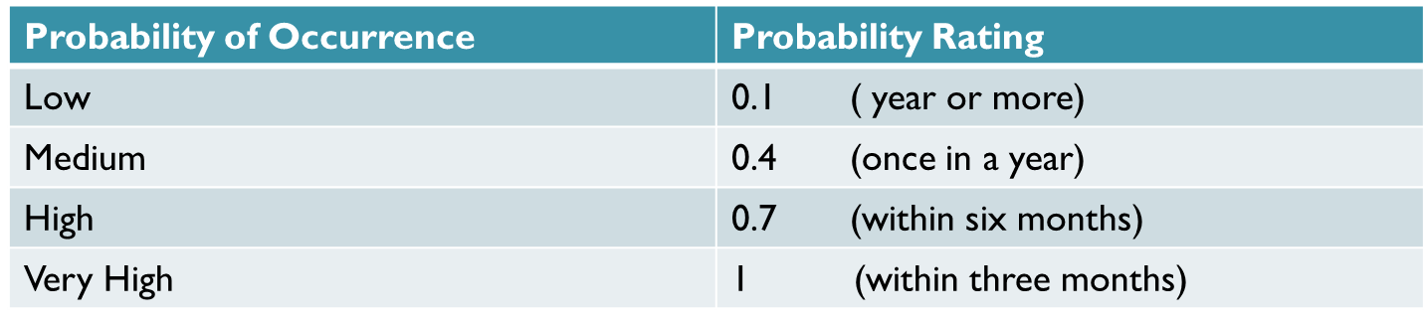
Calculating Probability of Occurrence
Risk Value = Asset Value x Business Impact x Probability of Occurrence of Threat
The probability of occurrence is required to understand the frequency at which such failures occur
This is based upon previous experiences and also looking at the current implementation.
The probability of occurrence is measured on a scale of 0.1 to 1
Let us consider the probability of occurrence to be rated at medium i.e. 0.4 for mail server

Slide 62
Calculating RISK Value
Since, we have all the values now, so we will calculate the Risk value by summing them all
Risk Value = AV x BI x P(T)
Risk Value= 10 x 4 x 0.4 = 16

